Slide 1
Where are we?
Review
Integration methods
Area between curves (top curve – bottom curve)
Today and Next Class
Calculate volumes
Disk method
Washer method
Cylindrical shell
etc

Slide 2
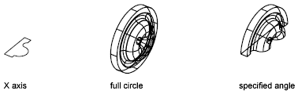
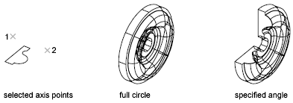
Math 152 – Lesson 9
Lesson | Topic | Reading
8 | Area Between Curves | 6.1
9 | Volumes | 6.2
10 | Volumes & Cylindrical Shells | 6.3
Objectives
Calculate volumes using the disk & washer methods

Slide 3
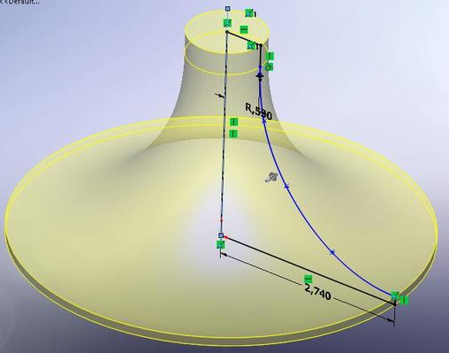
3D from Revolution

Slide 4
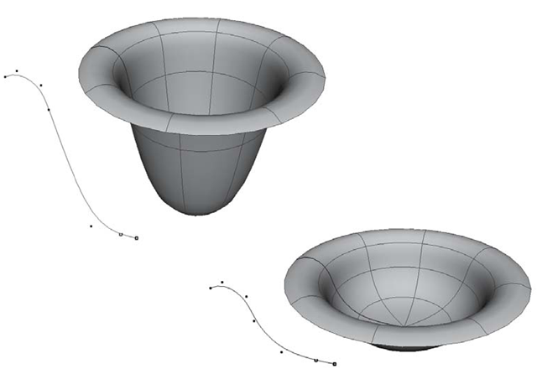
3D from Revolution

Slide 5
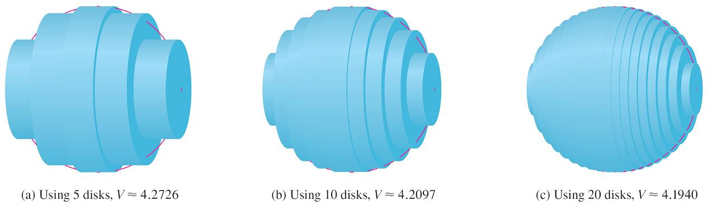
Volumes

Slide 6
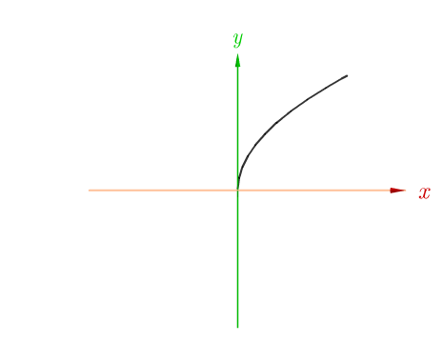
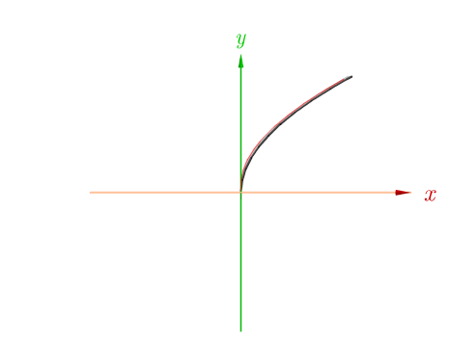
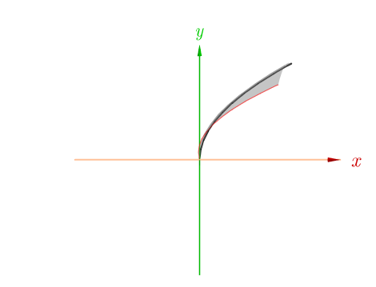
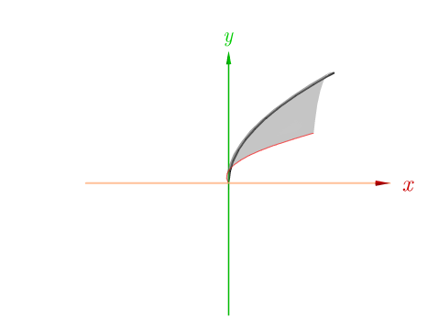
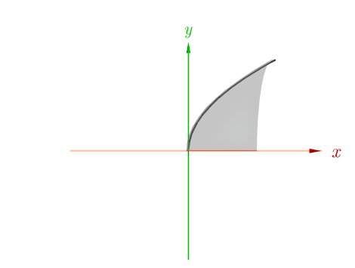
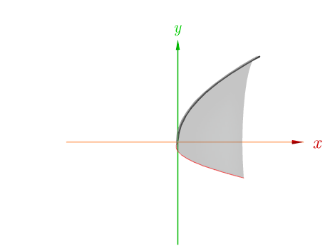
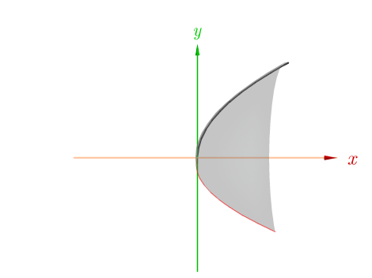
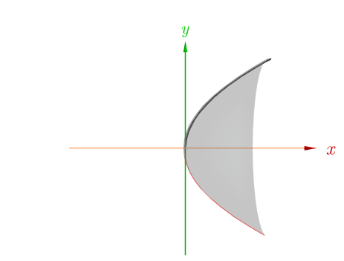

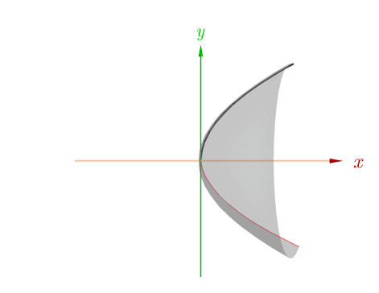
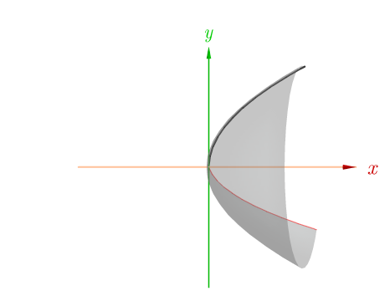
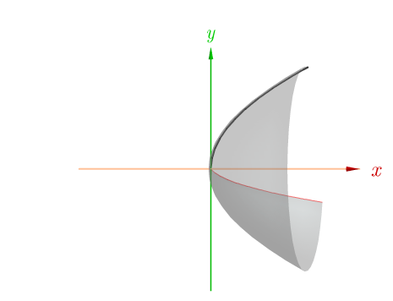
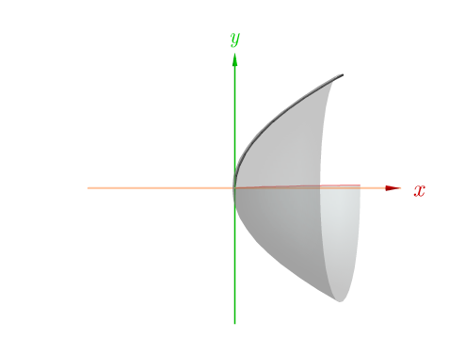
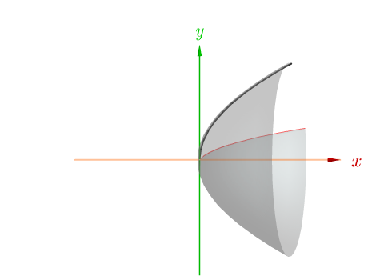
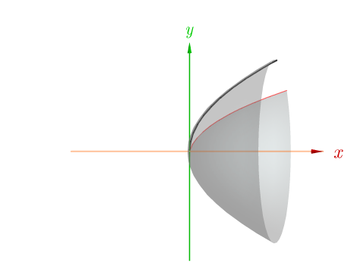
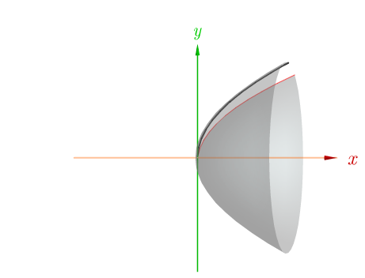
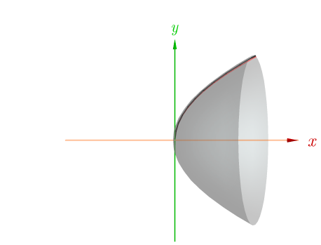
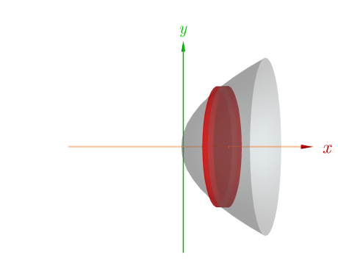
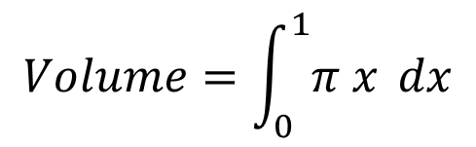




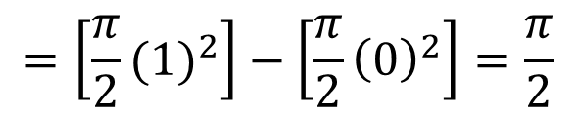
Disk Method
$$y=\sqrt{x}$$
$$V_{Slice}= π∙ r^{2} ∙∆x$$
$$=π {\left(\sqrt{x}\right)}^{2} ∆x$$
$$=π x ∆x$$
$$Volume=\int_{0}^{1}{π x} dx$$
$$=\left[\frac{π}{2}{(1)}^{2}\right]−\left[\frac{π}{2}{\left(0\right)}^{2}\right]=\frac{π}{2}$$
Revolve sqrt(x) about x-axis to make 3D object

Slide 7
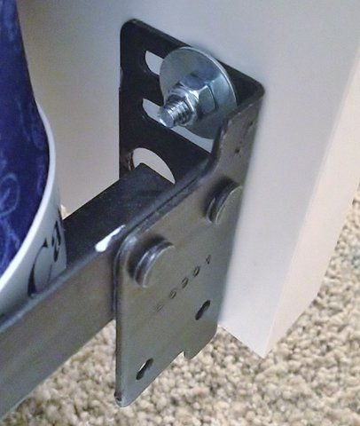
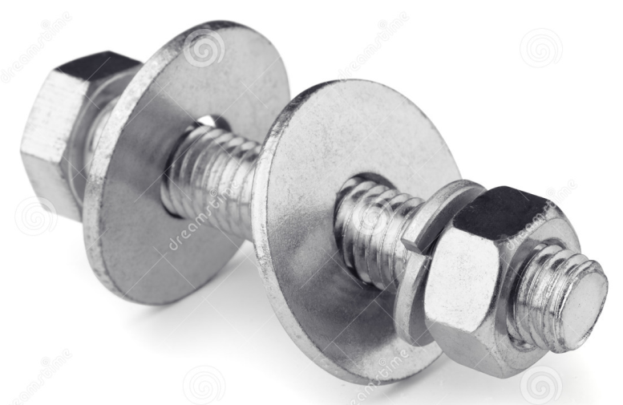
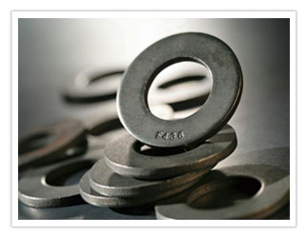
What is a washer???
A washer is a thin plate (typically disk-shaped) with a hole (typically in the middle) that is normally used to distribute the load of a threaded fastener, such as a screw or nut.

Slide 8
Washer Method
If the cross-section is a washer, we find the inner radius r_{in} and outer radius r_{out} from a sketch (as in Figure 10) and compute the area of the washer by subtracting the area of the inner disk from the area of the outer disk:
A = π (outer radius)² – π (inner radius)²
Figure 10

Slide 9
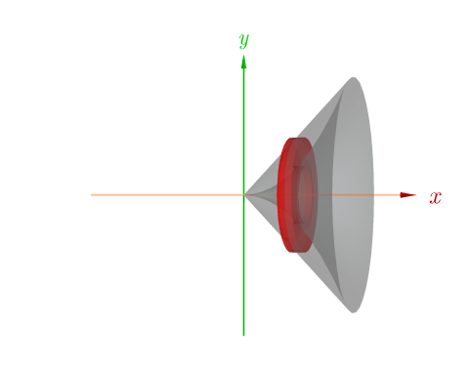
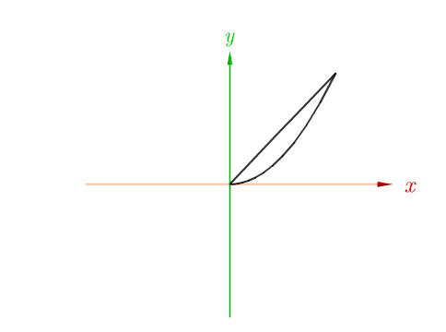
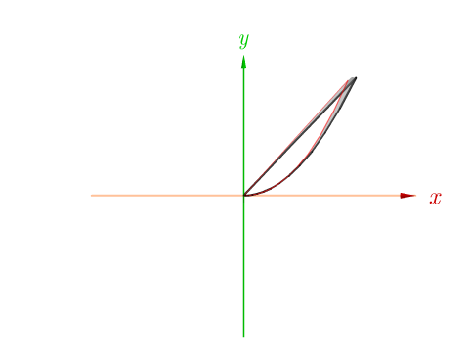
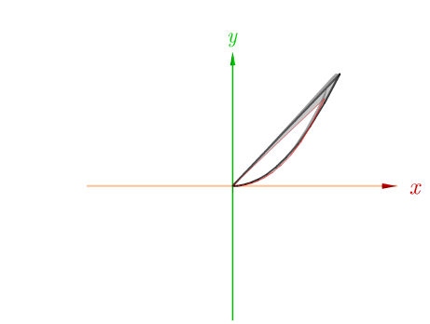
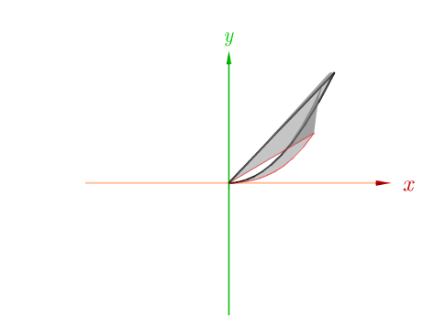
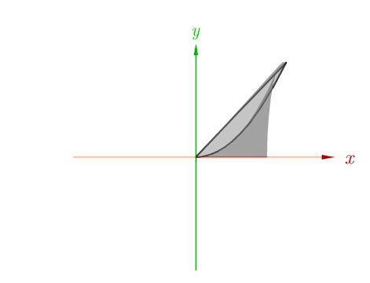
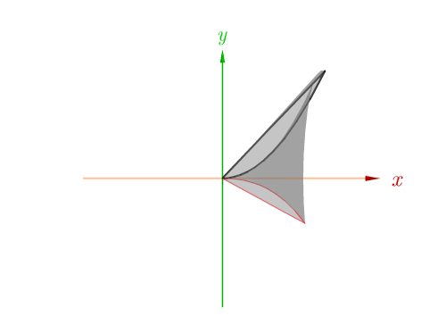
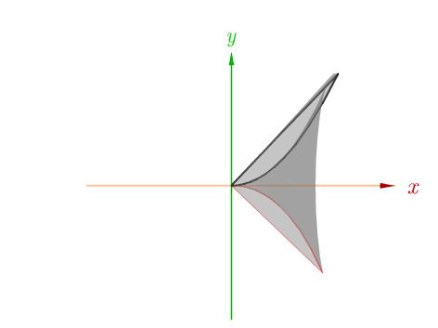
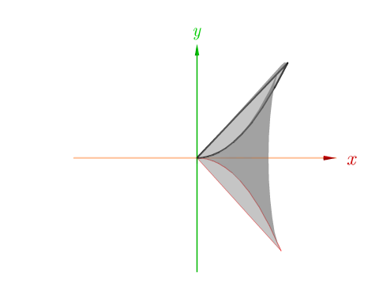
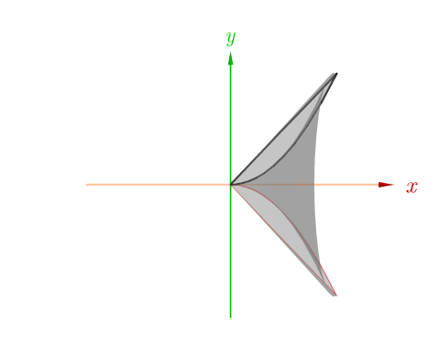
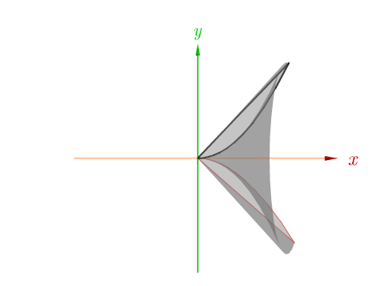
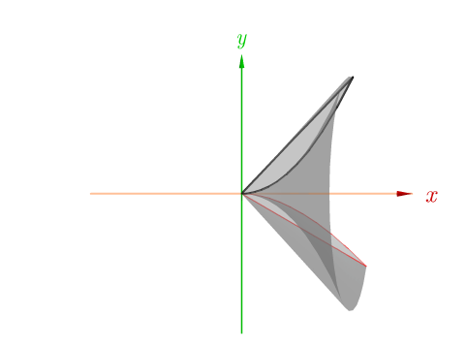
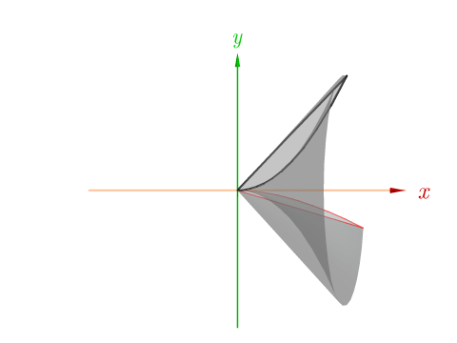
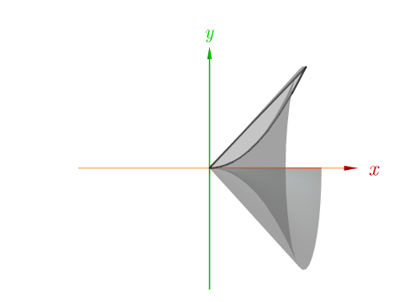
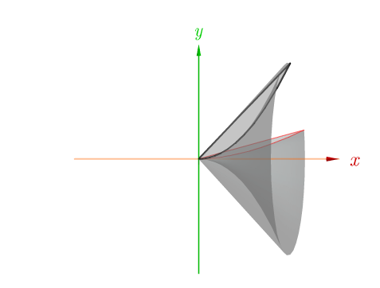
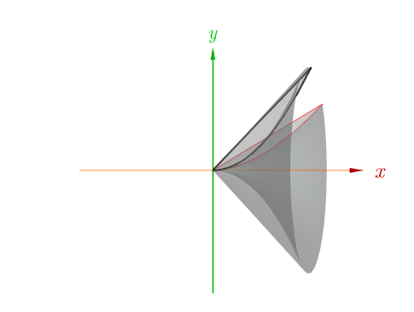
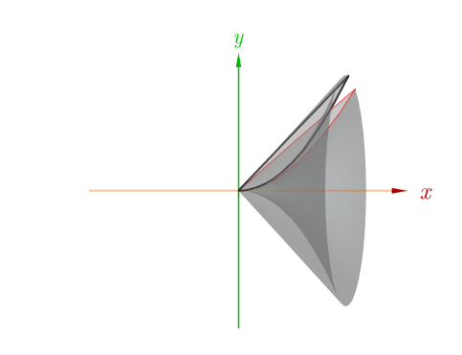
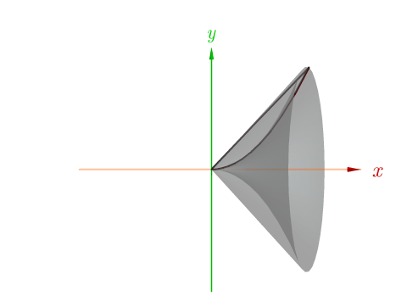
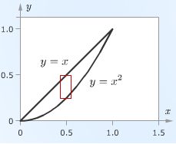




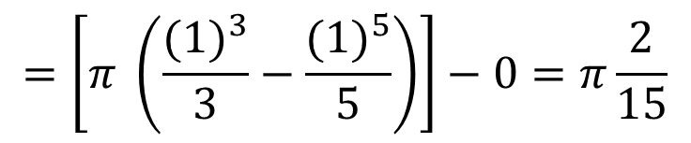
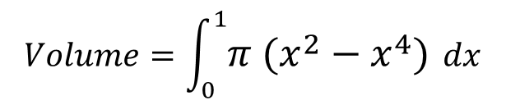
Washer Method
$y=x$
$y=x^{2}$
$$V_{Slice}= \left(π r{}_{out}^{2 }{ h}\right) − \left(π r{}_{in}^{2 }{ h}\right)$$
$$=\left(π {\left(x\right)}^{2}∆x\right)−\left(π {\left(x^{2}\right)}^{2}∆x\right)$$
$$=π (x^{2}−x^{4}) ∆x$$
$$Volume=\int_{0}^{1}{π (x^{2}−x^{4})} dx$$
$$=\left[π \left(\frac{{(1)}^{3}}{3}−\frac{{(1)}^{5}}{5}\right)\right]−0=π\frac{2}{15}$$
Revolve cross section about x-axis to make 3D object
Notes:
Could do shells (next lesson)
Length = (2pi)x
Ht = y^(1/2) – y
2pi/15

Slide 10
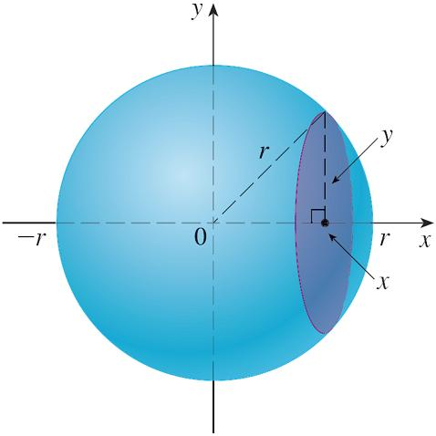
Disk Method: Example 1
Show that the volume of a sphere of radius r is .
Solution:
If we place the sphere so that its center is at the origin (see Figure 4), then the plane P_{x} intersects the sphere in a circle whose radius (from the Pythagorean Theorem) is
So the cross-sectional area is A(x) = π y²
Figure 4
= π (r² – x²)

Slide 11
Disk Method: Example 1 cont’d
Using the definition of volume with a = –r and b = r, we have
(The integrand is even.)
(The object is symmetric about the axes.)

Slide 12
Backups

Slide 13






Disk Method
x
$$\frac{w}{(5−x)}=\frac{10}{5}$$
$$A_{Slice}=w^{2}={\left[2(5−x)\right]}^{2}=\left(10−2x\right)2$$
$$w=2(5−x)$$
$$Volume=\int_{0}^{5}{{(10−2x)}^{2} dx}$$
$$=\frac{500}{3}$$
Notes:
$\int_{0}^{5}{{\left[2(5−h)\right]}^{2} dx}$ = $\int_{0}^{5}{{2(h}^{2}−10h+25) dx}$ = ${2((\frac{1}{3})h}^{3}−{5h}^{2}+25h,) evaluated from 0 to 5$
This is a square cone…general equation for the volume of a cone: V = (1/3)(cross-section of base)H
= ((1/3)(10)(10)(5) = 500/3

